Slide 1
Introduction to Smart Palate Speech Enhancement
Reporter：陳柏勳
Date: 2020/07/08

Slide 2
Outline
Scenario
Smart Palate
Model Structure
Performance
Model Structure (Electrical Signal Only)
Conclusion

Slide 3
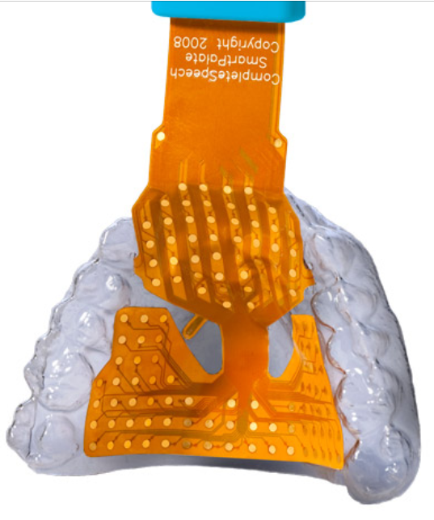
Scenario
Injury to the Vocal Folds
Articulation disorders
Environmental noise
Speech Enhancement
Audio signals
+ Auxiliary equipment
▲ Smart palate

Slide 4
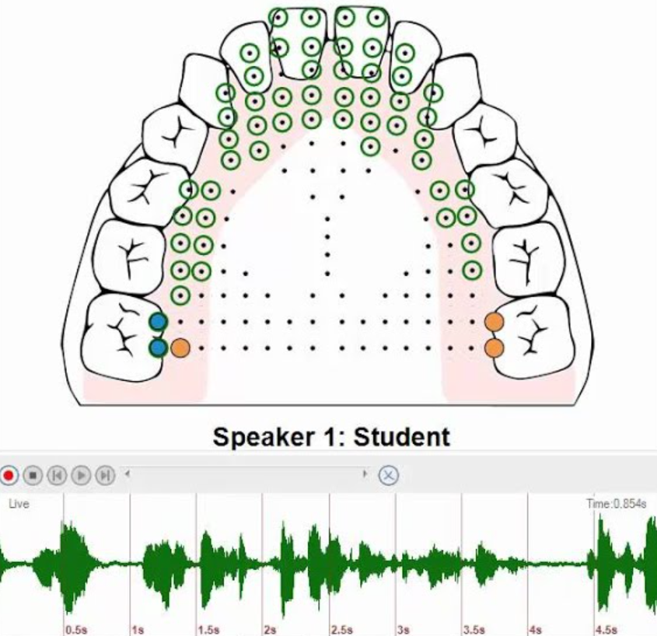
Smart Palate
124 gold sensors that capture tongue placement
Sampling rate: 100 Hz
With a microphone
Microphone Sampling rate: 44.1k Hz

Slide 5
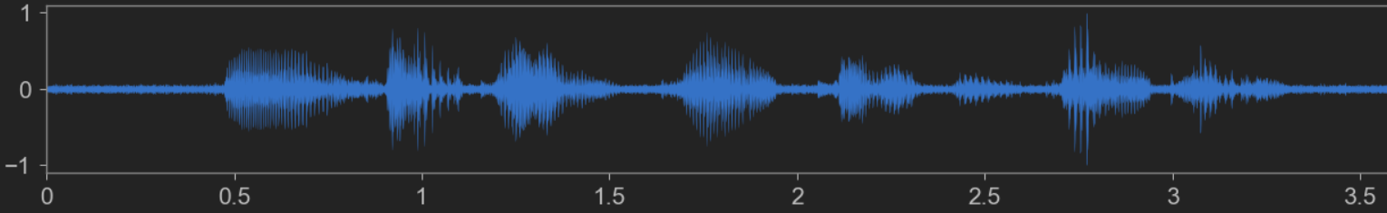
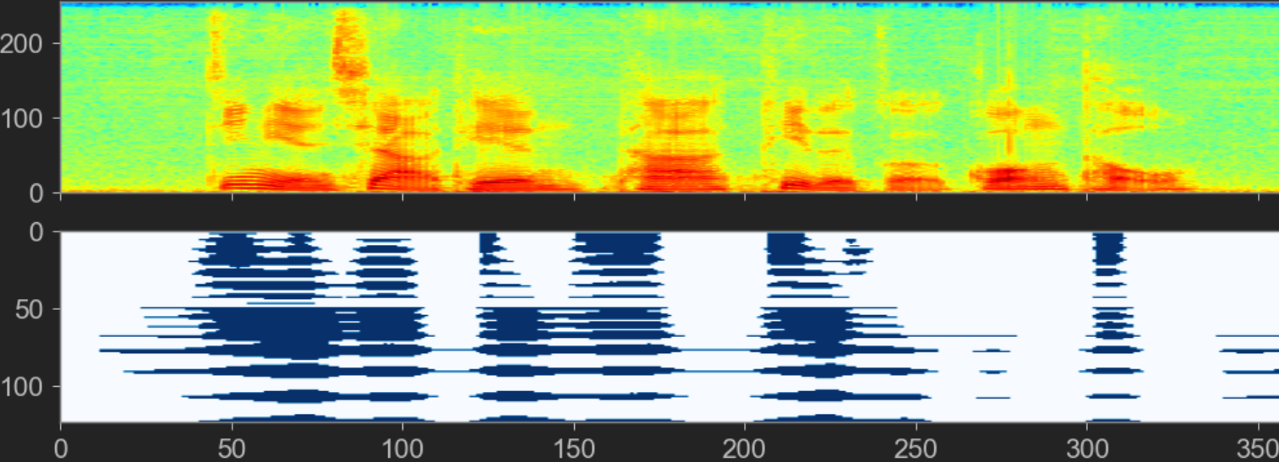

Slide 6
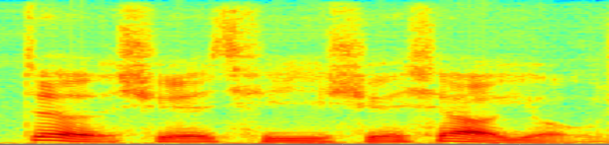
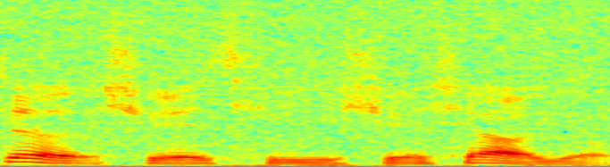
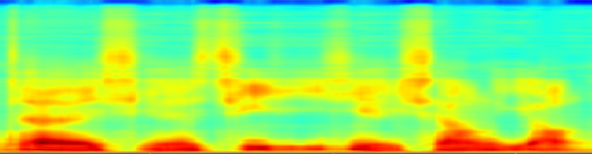







Model Structure
$$Y$$
CNN
CNN Block
CNN Block
Linear Layer
$$≈$$
$$S$$
$$S$$
Conv_1_1
ReLU
Conv_2_1
ReLU
$$\tilde{Y}$$
Conv_1_2
ReLU
Conv_2_2
ReLU
$$⃛$$
Linear(128)
Linear(257)
$$⋮$$
$$⋮$$
$$⋮$$
$$⋮$$
Conv_1_16
ReLU
Conv_2_32
ReLU
(1)
Linear(257)
ReLU(257)
$$E$$
(2)
.
.
.
$$⋮$$
LSTM(257)
$$\tilde{Y}$$
$$Y$$
$$loss=MSE ( , )$$
(3)
1 Layer Transformer Encoder

Slide 7
Experimental setup
Training Set
104 noise types
SNR: -20dB ~ 10dB
250 sentences
Test Set
SNR: -10dB ~ 15dB
70 sentences
Model Setting
loss function: MSE
batch size: 32
epoch: 40
Evaluation Metric
PESQ
STOI
ESTOI

Slide 8
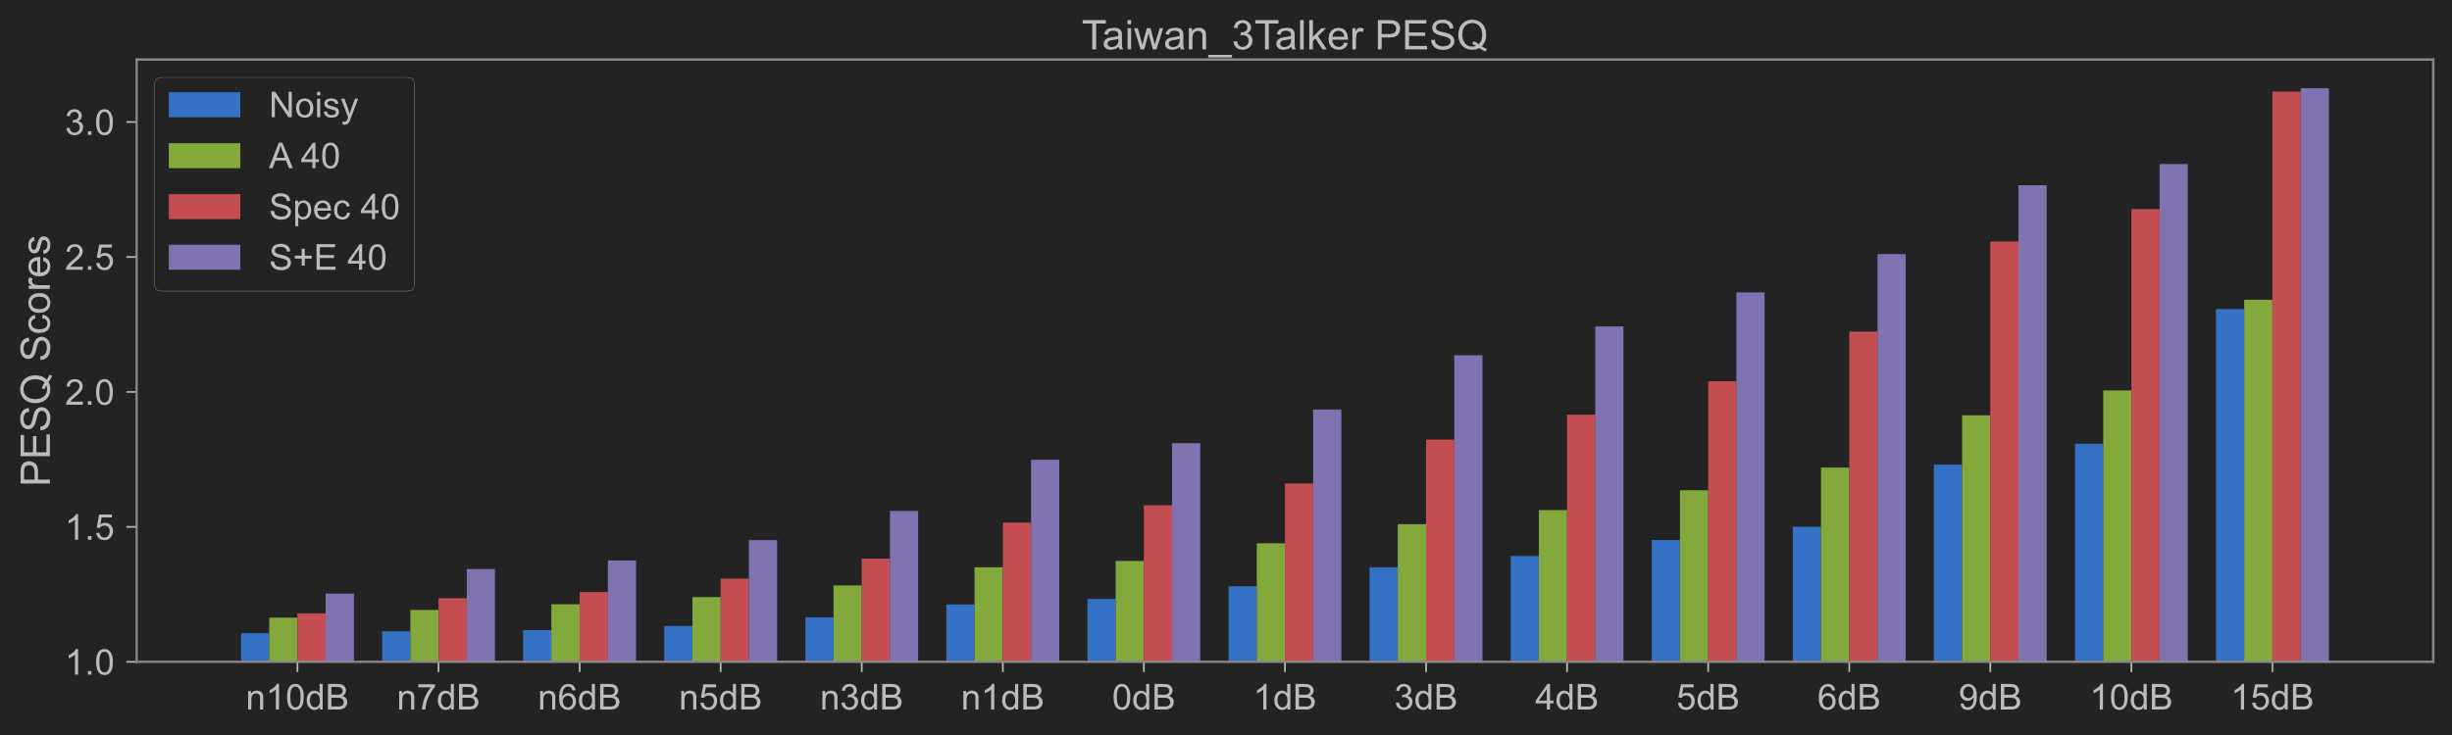
Performance - Intro
Use Spectrogram only
Use Spectrogram and Electrical Signal
SNR

Slide 9
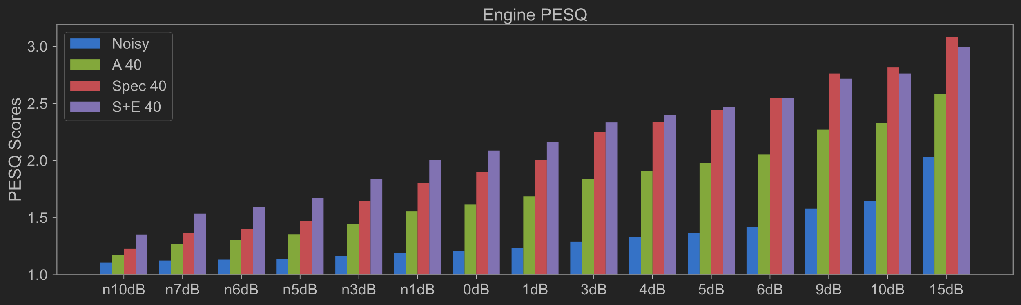
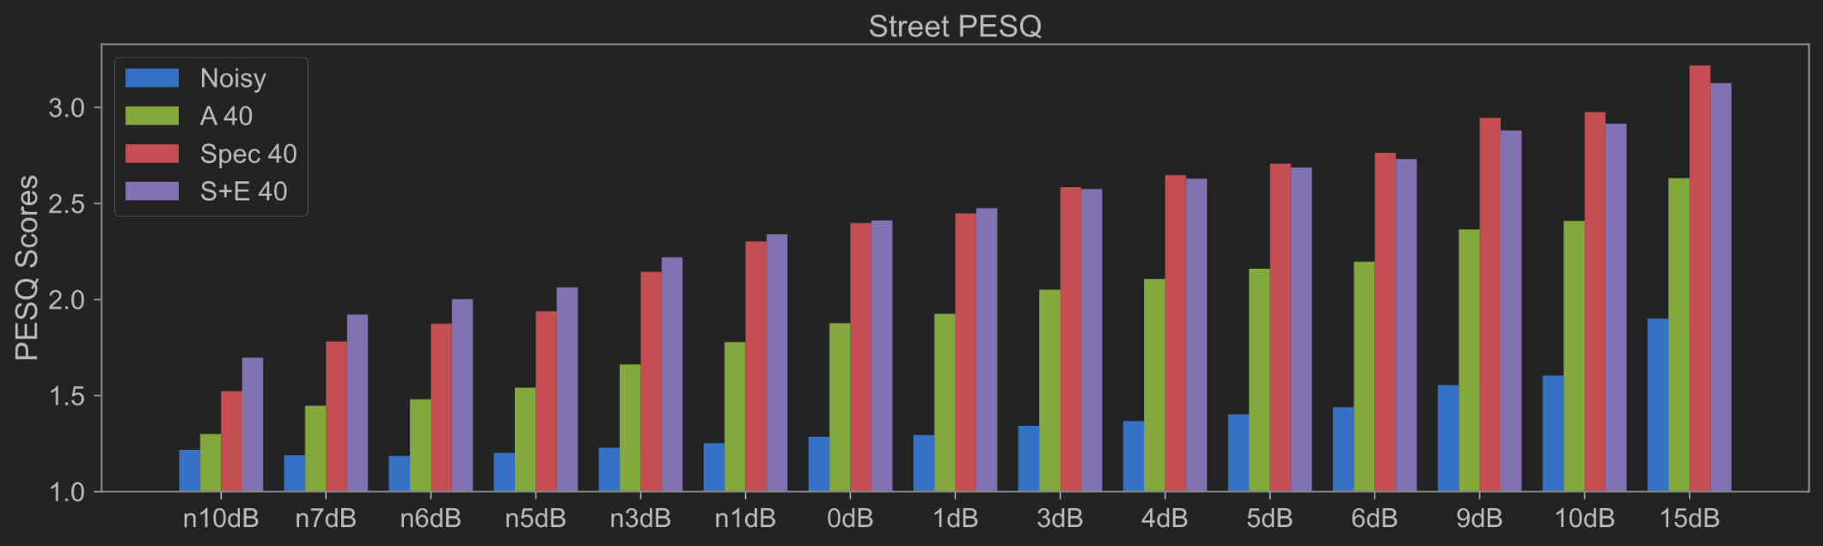
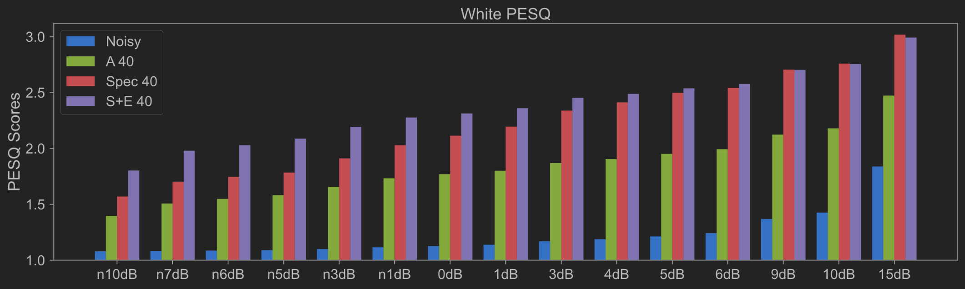
Performance - PESQ
Taiwan_3Talker noise
Engine
Street
White

Slide 10
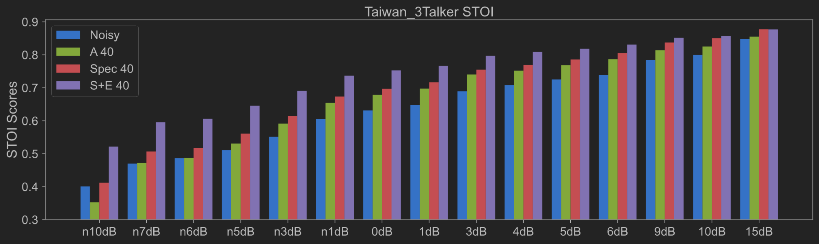
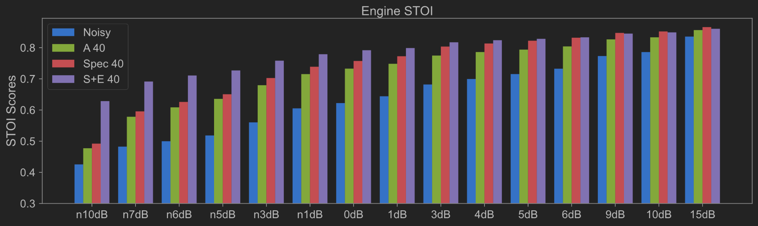
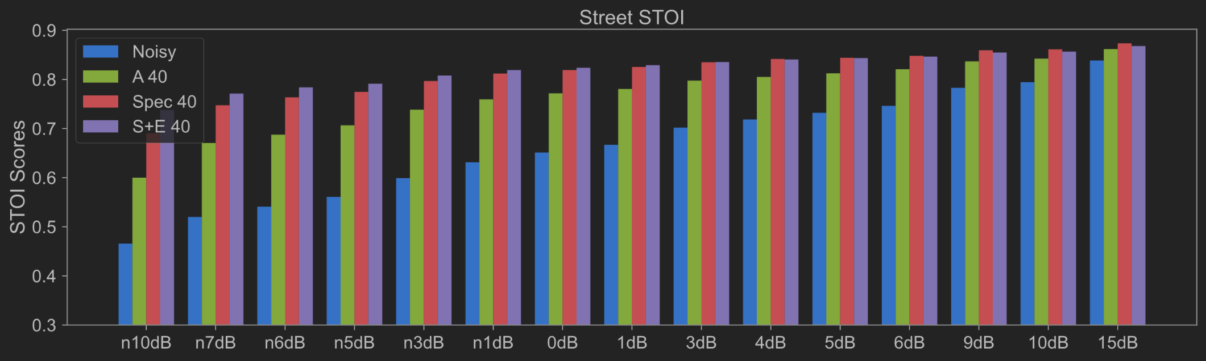
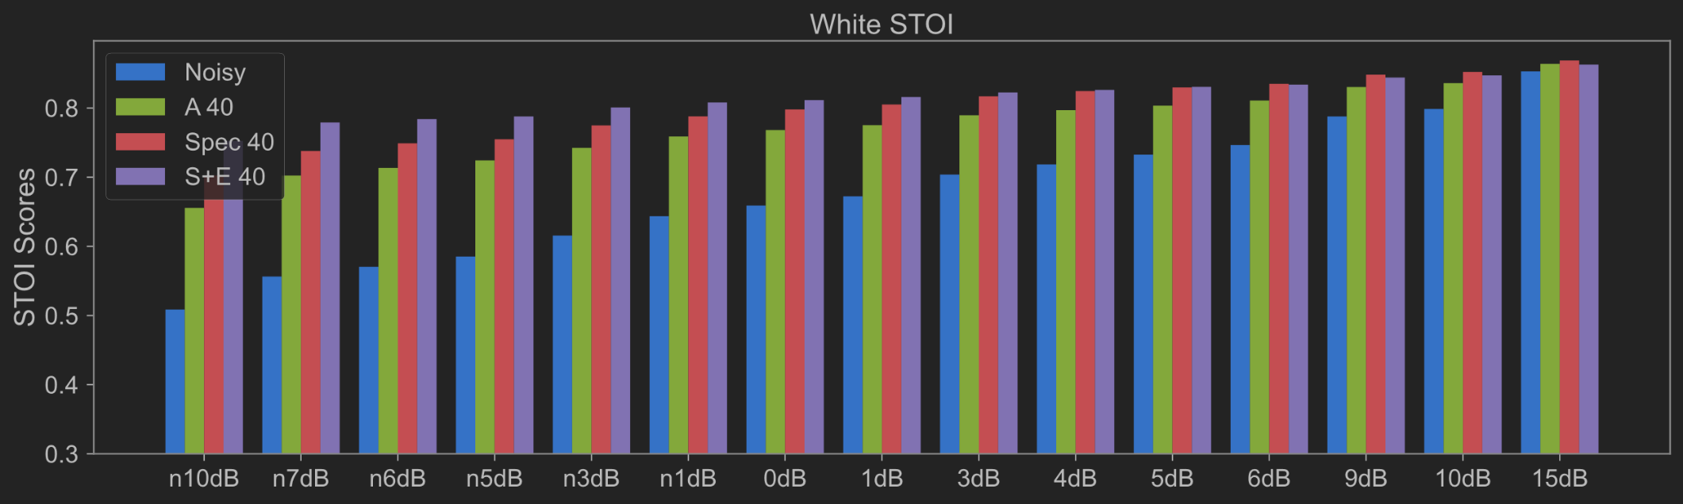
Performance - STOI
Taiwan_3Talker noise
Engine
Street
White

Slide 11
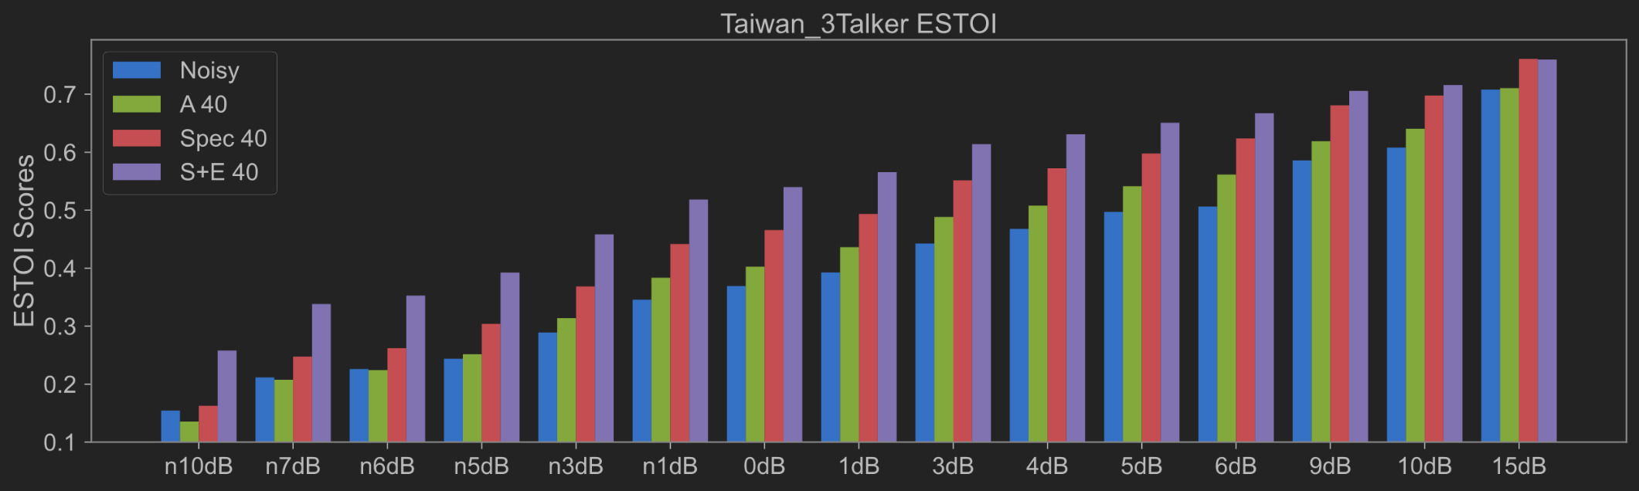
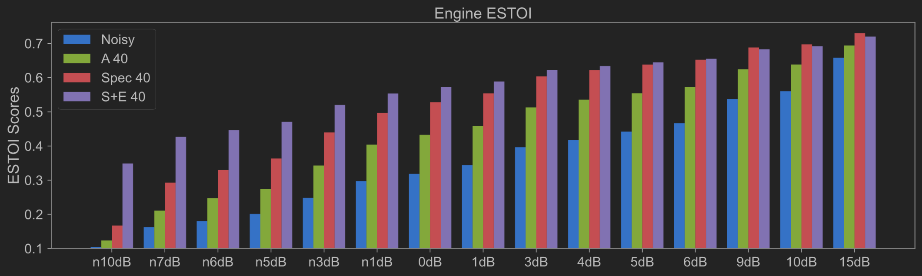
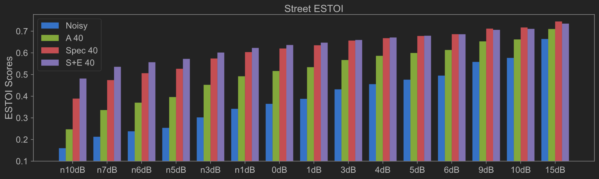
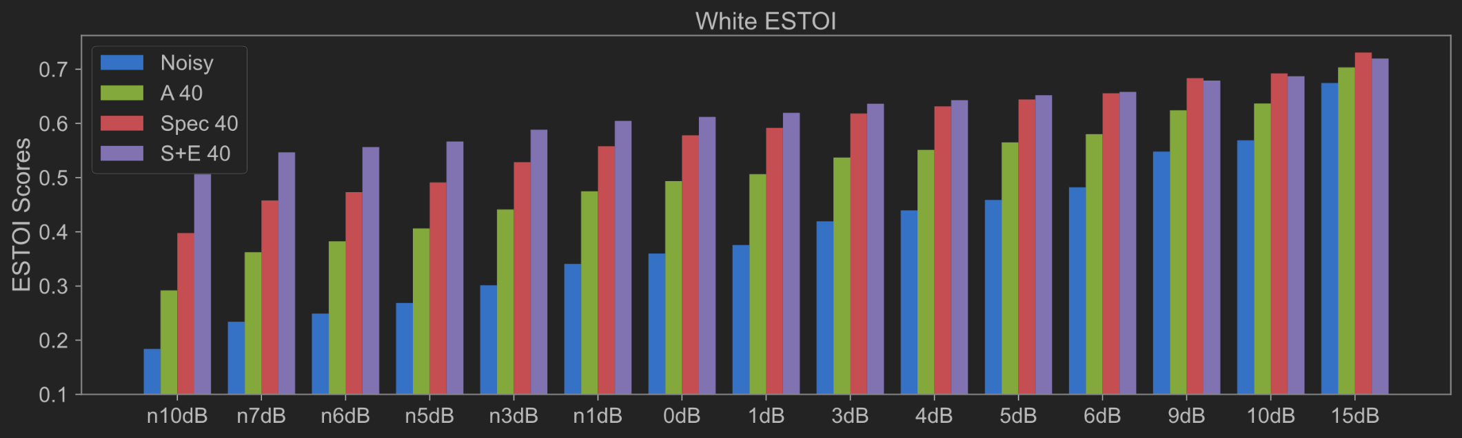
Performance - ESTOI
Taiwan_3Talker noise
Engine
Street
White

Slide 12
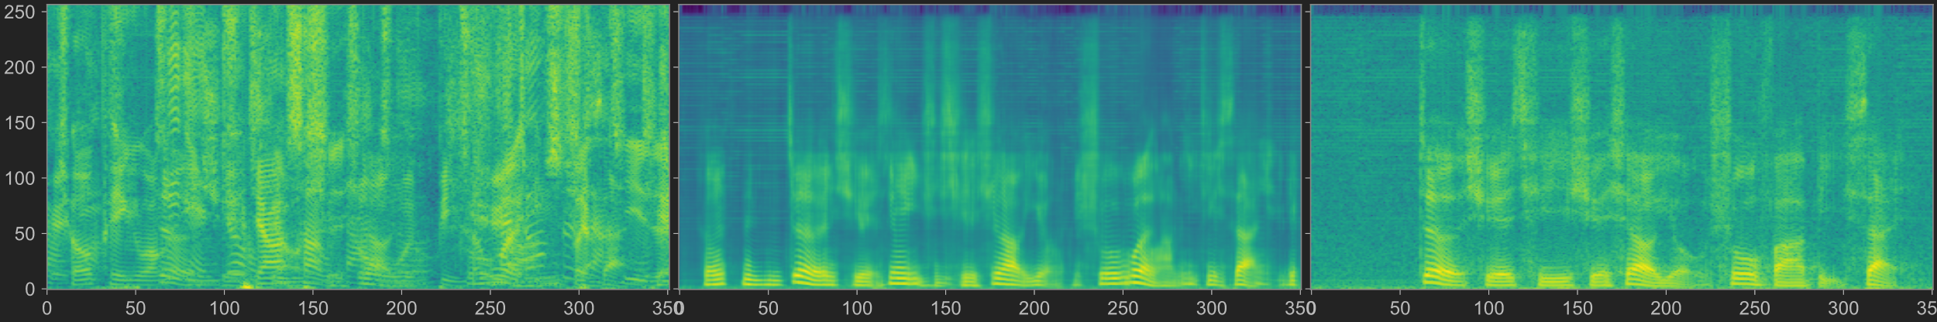
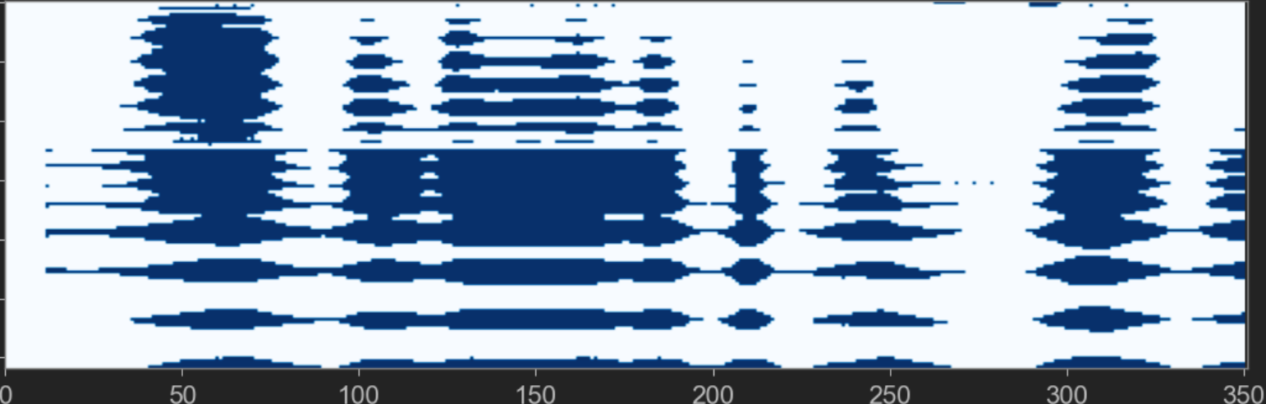
Performance on Taiwan_3Talker noise
SNR: -7dB
Enhanced
Clean
Electrical signal

Slide 13
Model Structure (Electrical Signal Only)
$$Y$$
CNN
CNN Block
CNN Block
Linear Layer
$$≈$$
$$S$$
Conv_1_1
ReLU
Conv_2_1
ReLU
$$\tilde{Y}$$
Conv_1_2
ReLU
Conv_2_2
ReLU
$$⃛$$
Linear(128)
Linear(257)
$$⋮$$
$$⋮$$
$$⋮$$
$$⋮$$
Conv_1_16
ReLU
Conv_2_32
ReLU
$$E$$
(2)
.
.
.
$$⋮$$
LSTM(257)
$$\tilde{Y}$$
$$Y$$
$$loss=MSE ( , )$$

Slide 14
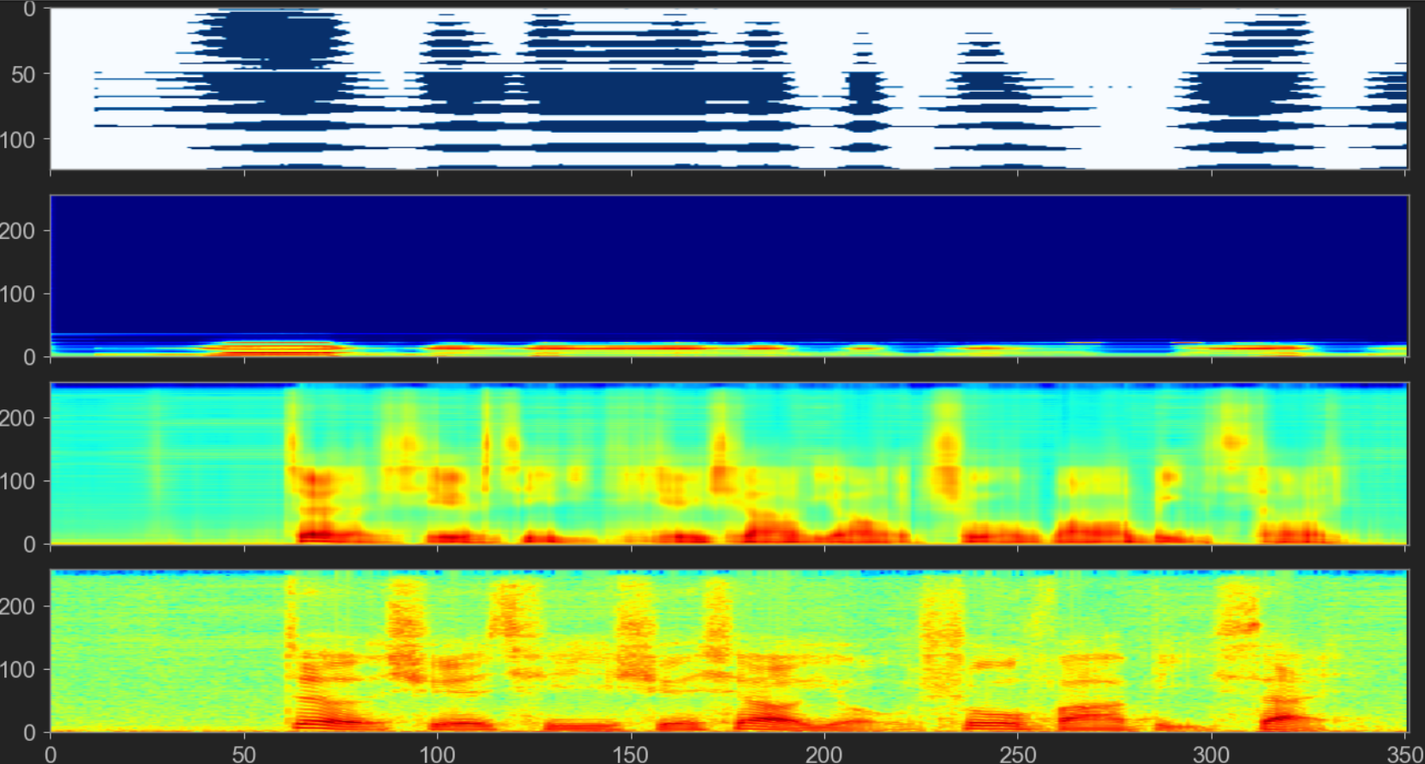
1 Layer LSTM
Electrical signal
Latent state
Enhanced
Reference

Slide 15
Conclusion
We use CNN to integrate two types of speech signals.
This structure improved PESQ, STOI, and ESTOI metric scores and outperforms the model which uses only audio signals for training.
Possible to train a model using electrical signals only.

